Slide 1
4 The Medium Access Control Sublayer

Slide 2
High Lights
Channel allocation algorithms
Contention：ALOHA,S-ALOHA,CSMA,CSMA/CD
Collision-Free Protocols : bit-map, binary countdown, Token
Limited-Contention Protocols
LAN
IEEE802.3, HIGH-SPEED LANS (802.3u)
Gigabit Ethernet(802.3z)
IEEE802.11(WLAN) LLC(802.2)
BRIDGE: transparent bridge
REPEATER,HUB, BRIDGE,SWITCH,ROUTER
VLAN

Slide 3
4.1 The Channel Allocation Problem

Slide 4
M/M/1 System

Slide 5
M/M/1 System
incoming number is K in period T
λ: mean arrival rate (frames/sec)
1/μ: mean frame length (bits/frame)
C: data transmission rate, channel capacity (bits/sec) , the service rate is µC frames/sec
mean time delay

Slide 6
M/M/1 Example
λ=200 μC=250
T=1/(250-200)=20ms

Slide 7
The Channel Allocation Problem
Static Channel Allocation in LANs and MANs
Dynamic Channel Allocation in LANs and MANs

Slide 8
Static Channel Allocation

Slide 9
Static Channel Allocation
Divide the single channel into N (TDM or FDM) independent subchannels, each channel capacity
mean arrival rate
mean time delay

Slide 10
Static Channel Allocation(2)
Single channel
C is 100 Mbps
Mean frame length, 1/µ, is 10,000 bits
µC=10000 frames/sec
Frame arrival rate is 5000 frames/sec
Mean delay = 200 µsec
Divide the channel into N
Replace the 100-Mbps network with 10 networks of 10 Mbps each and statically allocate each user to one of them
Mean delay = 2 msec

Slide 11
Dynamic Channel Allocation

Slide 12
Classification of Dynamic Channel Allocation
Controlled multiple access
Centralized: polling
Decentralized: token
Random multiple access
ALOHA
CSMA, CSMA/CD, CSMA/CA

Slide 13
Five Key Assumptions of Dynamic Channel Allocation
Station Model
Single Channel Assumption.
Collision Assumption
(a) Continuous Time.
(b) Slotted Time.
(a) Carrier Sense. (b) No Carrier Sense.

Slide 14
Station Model.
N independent stations, generates frames for transmission
The probability of a frame being generated in an interval of length t is λt, where λ is a constant (the arrival rate of new frames).
Once a frame has been generated, the station is blocked and does nothing until the frame has been successfully transmitted

Slide 15
Single Channel Assumption
A single channel is available for all communication
All stations can transmit on it and all can receive from it
All stations are equivalent, although protocol software may assign priorities to them.

Slide 16
Collision Assumption
If two frames are transmitted simultaneously, they overlap in time and the resulting signal is garbled
All stations can detect collisions
A collided frame must be transmitted again later

Slide 17
Continuous Time &Slotted Time.
Continuous Time
Frame transmission can begin at any instant
Slotted Time
Time is divided into discrete intervals (slots).
Frame transmissions always begin at the
start of a slot.
A slot may contain 0, 1, or more frames, corresponding to an idle slot, a successful transmission, or a collision, respectively.

Slide 18
Carrier Sense
Stations can tell if the channel is in use before trying to use it. If busy, no station will attempt to use it until it goes idle.
No Carrier Sense. Stations cannot sense the channel before trying to use it. They just go ahead and transmit. Only later can they determine whether the transmission was successful

Slide 19
4.2 Multiple Access Protocols

Slide 20
Multiple Access Protocols
ALOHA
Carrier Sense Multiple Access Protocols
Token
Collision-Free Protocols
Limited-Contention Protocols
Wireless LAN Protocols

Slide 21
ALOHA

Slide 22
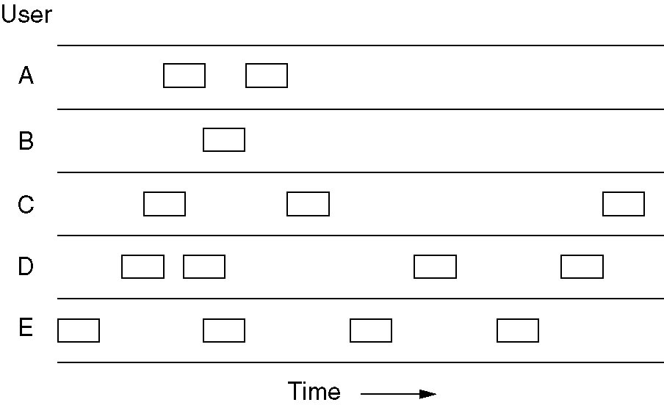
Pure ALOHA
In pure ALOHA, frames are transmitted at completely arbitrary times.

Slide 23
Pure ALOHA Model
Each station transmit frames arbitrarily
If collision occurs, the sender waits a random time and sends it again
N
N-1
2
1
Bus channel
interface
The model of ALOHA

Slide 24
Pure ALOHA: Collision Demo(1)
1
2
...
N-1
N
Collision reason：two station send frame simultaneously

Slide 25
Pure ALOHA: Collision Demo(2)
t1
t3
station A
A1
A2
A2
A2
A3
t
new frame
collison
t2
t4
Station B
B1
B1
B2
B2
B3
t
Final effect
A1
B1
A2
B2
t

Slide 26
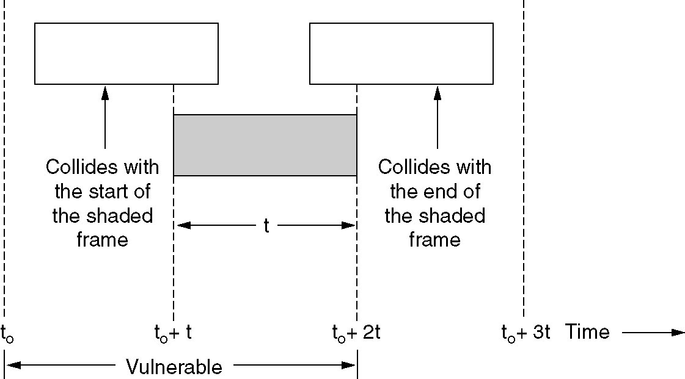
Pure ALOHA:Performance Analysis(1)
Vulnerable period for the shaded frame.

Slide 27
Pure ALOHA: Performance Analysis(2)
Assumptions
Fixed frame length, frame time is t
Frames generated according to Poisson distribution
New frames and retransmitting frames also accord to Poisson distribution
Parameters
Throughput S: mean successful frames per frame time 0≤ S ≤ 1
Network load G: mean frames per frame time G≥S
probability P₀: successful transmission
S = G × P₀

Slide 28
Pure ALOHA: Performance Analysis(3)
P₀= P [no other traffic being initiated during the entire vulnerable period] = e ^{–λ(2T)} = e ^{–2G}
[ P=(λT)^{K} e^{-λt}/K!]
Throughput: S = G × P₀ = G e ^{-2G}
Maximum throughput occurs when G=0.5, S=1/2e ≈ 0.184

Slide 29
Slotted ALOHA
Principle
Divide time into discrete intervals, each interval corresponding to one frame, so each user must know slot boundaries (synchronization)
t1
A2
A3
A1
A2
station A
new frame
collision
B1
B2
t2
B2
B3
station B
final effect
A1
B1
B2
A2
A3
B3

Slide 30
Slotted ALOHA(2)
T_{x}
T
P₀= P [ arrival interval > T ] = e ^{- λ T} = e ^{–G}
Throughput S = G × P0 = G e ^{-G}
Maximum throughput occurs when G=1, S=1/e ≈ 0.368
[ P=(λT)^{K} e^{-λT}/k!= =G^{K} e^{-G}/k!]
When G=1
37%: Slots empty
37%: Successes
26%: Collisions

Slide 31
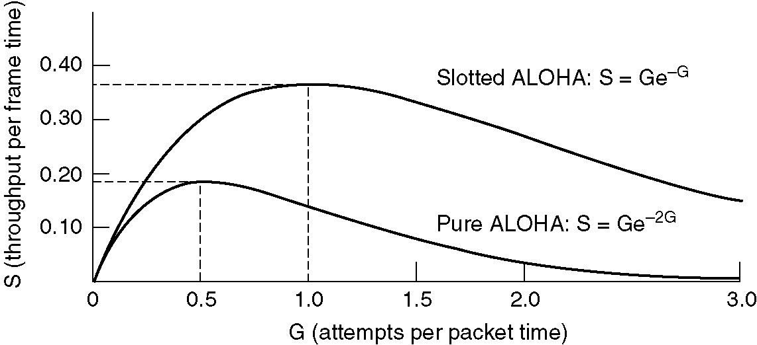
ALOHA Summary
Throughput versus offered traffic for ALOHA systems.

Slide 32
Expected number of transmissions
Pure ALOHA
P₀=e^{-2G}
P_{k}=e^{-2G}(1-e^{-2G})^{k-1}
E= ∑kP_{k}=e^{2G}
Slotted ALOHA
P₀=e^{-G}
P_{k}=e^{-G}(1-e^{-G})^{k-1}
E= ∑kP_{k}=e^{G}
Higher values of G reduces number of empties but increases number of collisions exponentially

Slide 33
Carrier Sense Multiple Access Protocols (CSMA)

Slide 34
CSMA protocols
Station listens for a carrier before Sending
Classification
1-persistent CSMA
If the channel is busy, waits until it becomes idle, then transmits frame immediately,
If a collision occurs, waits for a random amount of time and start all over again.
Nonpersistent CSMA
if the channel is busy, waits for a random amount of time and sense channel again

Slide 35
CSMA protocols
P-persistent CSMA (slotted channel)
If the channel is busy, waits to the next slot
If idle, transmits frame with probability of p, with a probability of q=1-p it defers to the next slot
Repeated until either the frame has been transmitted or another station has begun transmitting
If there had been a collision, waits a random time and starts again

Slide 36
CSMA Comparison
1-persistent CSMA
Low delay when low load
Low throughput when high load
Nonpersistent CSMA
High throughput when high load

Slide 37
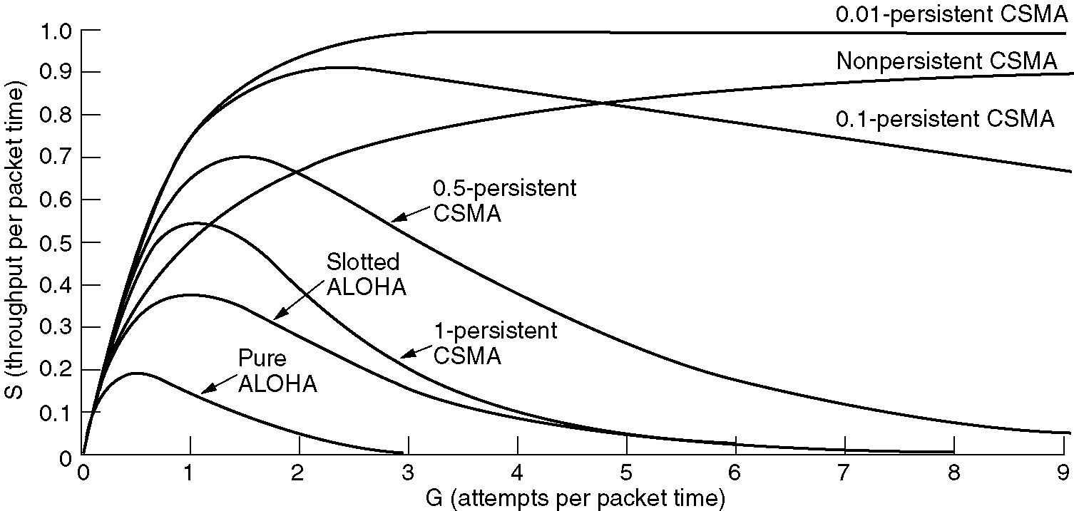
Persistent and Nonpersistent CSMA
Comparison of the channel utilization versus load for various random access protocols

Slide 38
CSMA Collision Reasons
1. Two or more stations sense the channel to be idle and begin transmitting
2. Propagation time : τ
Station A
Station B
A detects
an idle channel
τ
B detects an idle channel
ε,
τ:Propagation time between A and B

Slide 39
CSMA with Collision Detection（CSMA/CD）
Principle
Station aborts the transmission as soon as it detects a collision, it saves time and bandwidth
1-persistent CSMA/CD
When a station sense the channel idle, send immediately and keep on sensing, when collision occur, abort transmission immediately

Slide 40
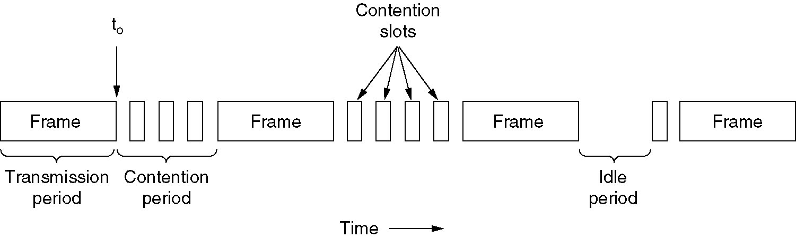
CSMA/CD: Channel state
CSMA/CD can be in one of three states: Contention, Transmission, or Idle.

Slide 41
CSMA/CD: Contention period
Station A
Station B
T_{B}
τ
B sense idle
2τ
A sense collision
B sense collision
2τ
T_{B}<= τ
τ: single trip propagation
contention period =
2 τ

Slide 42
CSMA/CD: Contention period(2)
CSMA/CD with a single channel is inherently a half-duplex system

Slide 43
Collision-Free Protocols

Slide 44
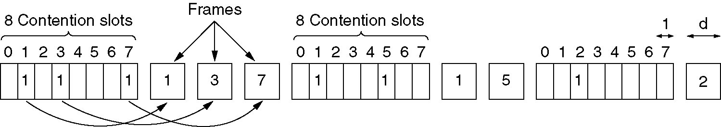
Basic bit-map protocol
Principle
Each contention period consists of N slots (bits), with each station use one slot
If station have frames to send, it reserve it by fill ‘1’ in its slot, (reservation protocols)

Slide 45
Bit-map protocol: Performance
N station, contention time is N
One data frame is d bits, so time is d
Low load
Efficiency= d/(N+d)
High load
All stations have frames to send, so the N bits contention period prorated over N frames, yielding an 1 bit overhead per frame
Efficiency=d/(d+1)

Slide 46
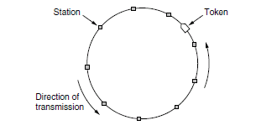
Token Ring

Slide 47
Properties
The ring is a single, shared medium All nodes see all frames.
A distributed algorithm determines when a node can transmit.
Data always flows in one direction.
Basic idea: A token circulates around the ring. When a host has a frame to transmit, it seizes the token and injects the frame on the medium. The frame is forwarded by intermediate nodes until arriving at the destination. The destination puts the frame back after receiving it, but with a “special mark”. The frame circulates back to the sender.

Slide 48
令牌环 操作
D
T
D
A
T = 0
C
T = 0
C
A
A
A
T
B
B
D
T
C
Data
T
C
Data
A准备截获令牌
A释放令牌
A
T = 1
C
A
T
C
Data
T
C
Data
B
A发数据

Slide 49
Protocol of token
Token ring
802.5
Token bus
802.4

Slide 50
binary countdown protocol
Problem
Basic bit-map protocol: the overhead is 1 bit per station
It does not scale well to networks with thousands of stations
Solution：Using binary station addresses
Principle
Each station wanting to use the channel broadcast its address as a binary bit string
The bits in each address position from different stations are BOOLEAN ORed together
Efficiency
d/(log₂N+d)
Disadvantage
high-numbered station always gets high priority to send
Variation: set the lowest priority to the station which send successfully in the last contention

Slide 51
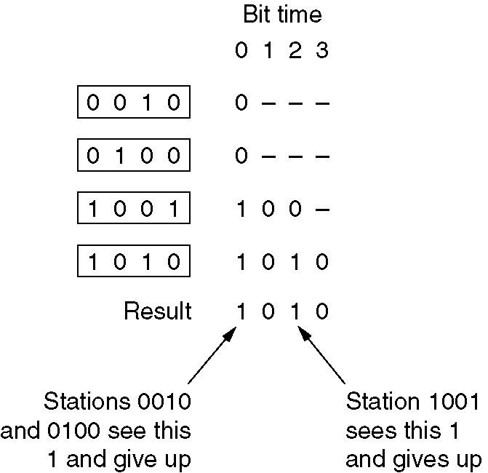
Binary Countdown protocol
A dash indicates silence

Slide 52
Limited-Contention Protocols

Slide 53
Limited-Contention Protocols
Basic strategies for channel acquisition
Contention:CSMA/CD
Collision-free methods: Bit-map
Performance measures
Delay at low load
Channel efficiency at high load

Slide 54
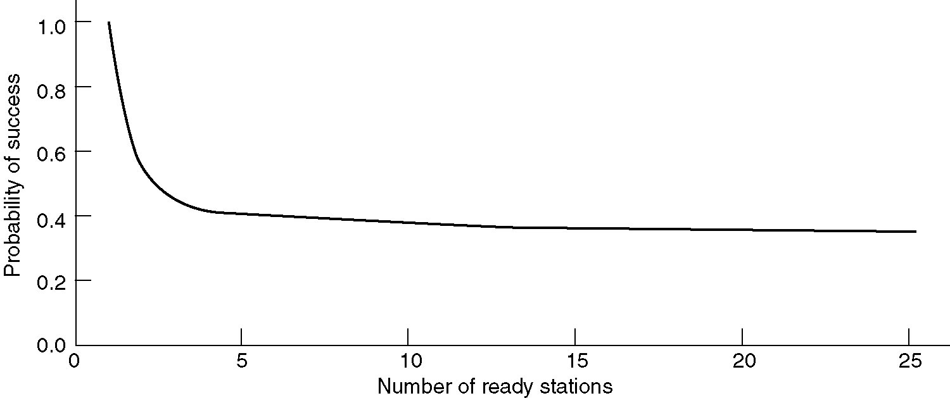
Performance of Symmetric Contention
P=1/k, A=(k-1/k)^{k} ^{– 1}
Acquisition probability for a symmetric contention channel
The probability of some station acquiring the channel can be increased only by decreasing the amount of competition

Slide 55
Limited-Contention Protocols
Limited-contention protocols
Use contention at low load, use a collision-free technique at high load
Divide stations into groups, each station contends the group’s slot

Slide 56
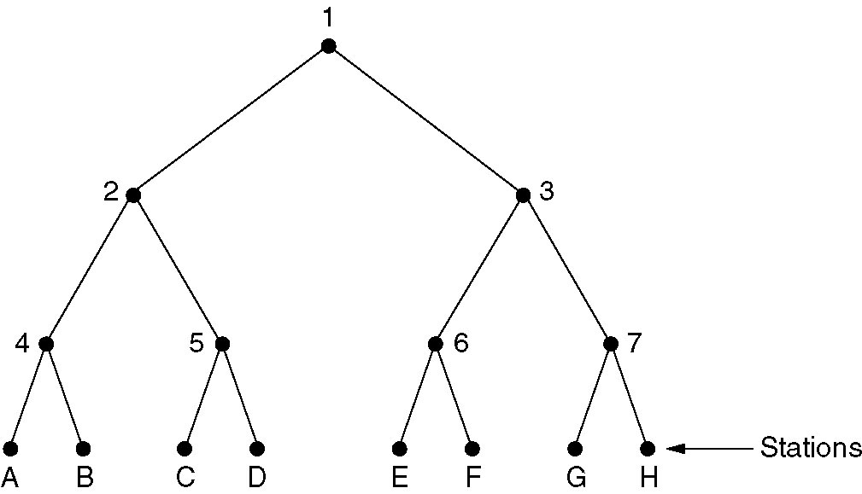
Adaptive Tree Walk Protocol
depth search first
build a binary tree with stations as the leaves
all stations contend slot 0
if no collision, ok
else only stations falling under node 2 compete slot 1
Slot 0
Slot 1

Slide 57
Improvements to Adaptive Tree Walk Protocol
G and H being the only ones wanting to transmit
Level 0
1
Slot 0
Level 1
2
slot1
3
Level 2
4
5
6
Slot 2
7
Level 3
Slot 3
slot4
station
A
B
C
D
E
F
G
H

Slide 58
Wireless LAN Protocols

Slide 59
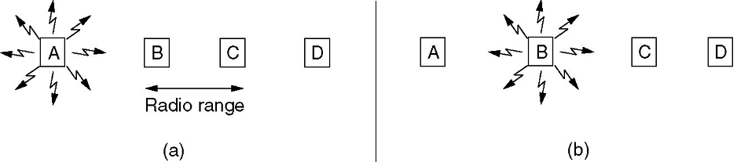
Problems
Radio transmitter & receiver
Radio transmitters have some fixed range.
In some wireless LANs, not all stations are within range of one another
Interference at the receiver, not at the sender
CSMA/CD is not appropriate
Hidden station problem
Exposed station problem
(a) A transmitting (b) B transmitting

Slide 60
Solutions
PCF (Point Coordination Function)
Uses the base station to control all activity in its cell
Base station broadcasts a beacon frame periodically
The beacon frame contains system parameters. It also invites new stations to sign up for polling service
Once a station has signed up, it is effectively guaranteed a certain fraction of the bandwidth
DCF (Distributed Coordination Function)
CSMA/CA:CSMA with Collision Avoidance, MACA(Multiple Access with Collision Avoidance) protocol

Slide 61
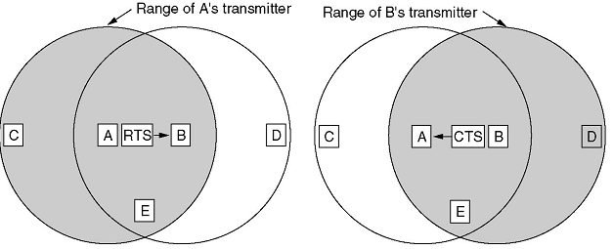
MACA: Collision Avoidance
A sends an RTS frame to B (30 bytes, contains data length)
B replies with a CTS frame(contains data length from RTS)
Upon receipt of the CTS frame, A begins data transmission
Stations hearing RTS remain silent long enough (C,E)
Stations hearing CTS remain silent during the upcoming data transmission (D,E)
RTS: Request To Send
CTS: Clear To Send

Slide 62
4.3 Ethernet

Slide 63
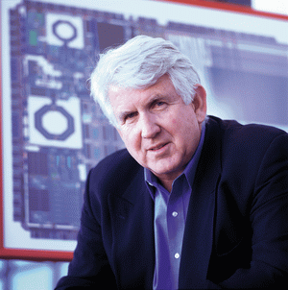
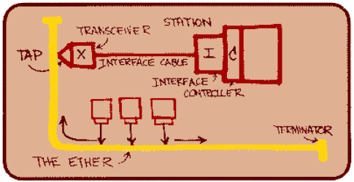
Bob Metcalfe’s Vision
June 1976 National Computer Conference
(INTEL had just developed 8080, running at 4.77M)
Robert Metcalfe (1946~)
1969 Graduated from MIT
1973 Harward (Ph.D)
1972~1979 Xerox PARC (Palo Alto Research Center)
1973 Ethernet, 3Mbps
1979~1990 3Com

Slide 64
Early History
1973 | Xerox PARC begins development of bus topology LAN
1976 | Successful CSMA/CD system to connect 100 workstations on 1 km cable
1980 | Digital Equipment Corp, Intel Corp, and Xerox release de-facto Ethernet DIX standard
1980 | IEEE 802 Standardization process begins
1983 | IEEE 802.3 Standard Published

Slide 65
Ethernet
Ethernet Cabling
Manchester Encoding
Ethernet MAC Sublayer Protocol
Binary Exponential Backoff Algorithm
Ethernet Performance
Switched Ethernet
Fast Ethernet
Gigabit Ethernet
10 Gigabit Ethernet
Retrospective on Ethernet

Slide 66
Ethernet Cabling

Slide 67
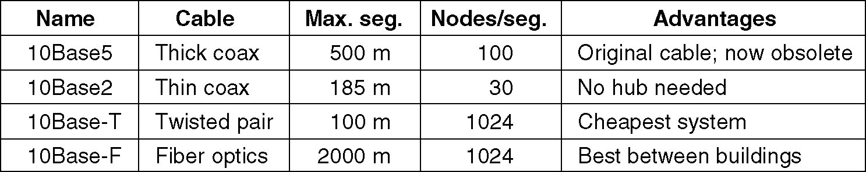
Ethernet Cabling
The most common kinds of Ethernet cabling.

Slide 68
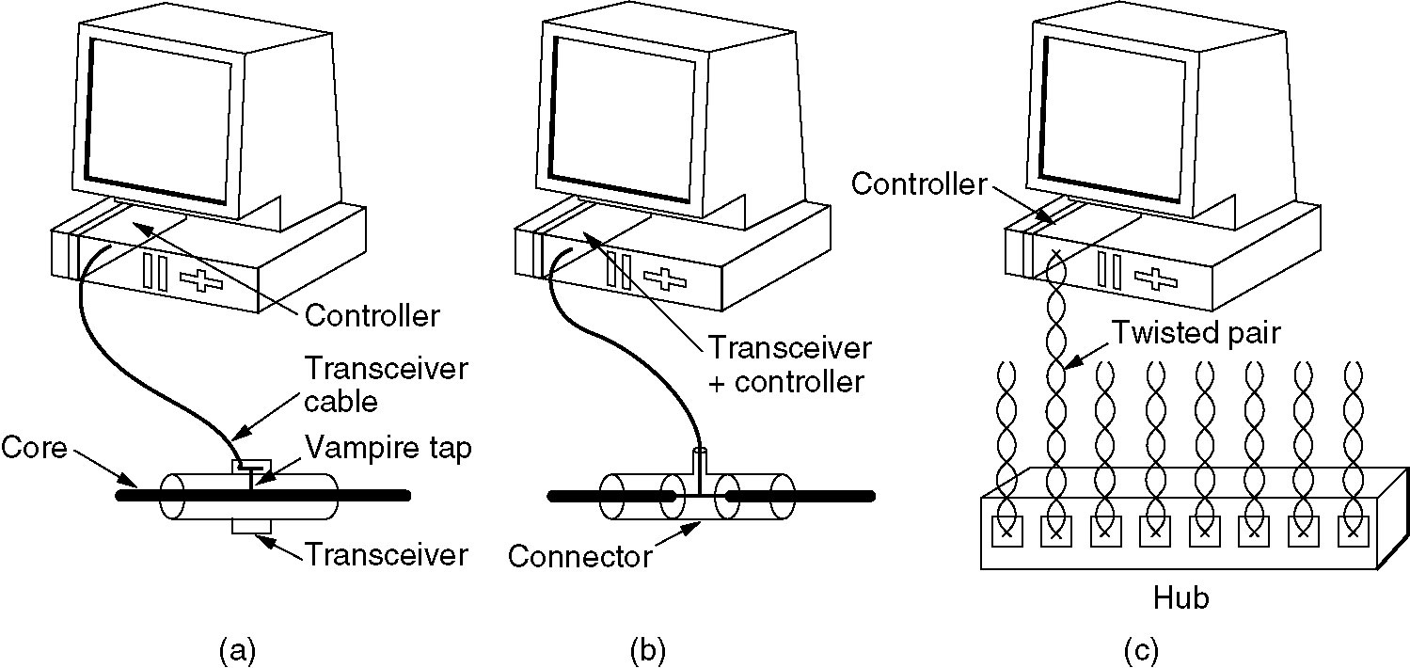
Ethernet Cabling:AUI,BNC,UTP5
Three kinds of Ethernet cabling.
(a) 10Base5, (b) 10Base2, (c) 10Base-T.

Slide 69
10Base5: Thick Ethernet(1)
Cable
Φ10, Coax, 500m
Connections to it are generally made using vampire taps, in which a pin is very carefully forced halfway into the coaxial cable's core
Transceiver cable
Connects the transceiver to an interface board in computer
Up to 50 meters long
Contains five individually shielded twisted pairs
Two of the pairs are for data in and data out
Two more are for control signals in and out
The fifth pair, not always used, allows the computer to power the transceiver electronics

Slide 70
10Base5: Thick Ethernet(2)
Interface board
Transmits and receives frames, assembling data into proper frame format, processing checksums
Manage a pool of buffers for incoming frames, a queue of buffers to be transmitted, direct memory transfers with the host computers
Transceiver
Handle carrier detection and collision detection
For collision, puts a special invalid signal on cable to ensure that all other transceivers also realize that a collision has occurred

Slide 71
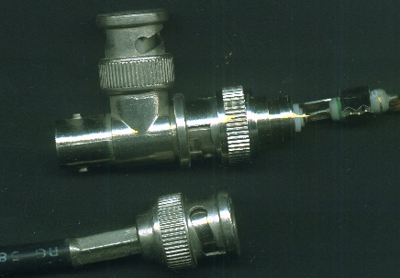
10Base2: Thin Ethernet
Cable: Φ5, Coax, 185m
BNC T-junction connector
Transceiver electronics are on the controller board

Slide 72
10BaseT
10Base-T: No shared cable at all
HUB
Station is connected to HUB by a dedicated cable (Max 100m)
A box full of electronics
物理上星状结构，逻辑上总线结构
任意站发送，所有站接收
媒体信号的再生（放大和整形）
RJ-45, 5 UTP (Unshielded Twisted Pairs)
两对线，分别用于收和发
差分传输：减少电磁干扰
同一线对的绞合：减少近端串扰
3UTP
STP: Shielded Twisted Pairs

Slide 73
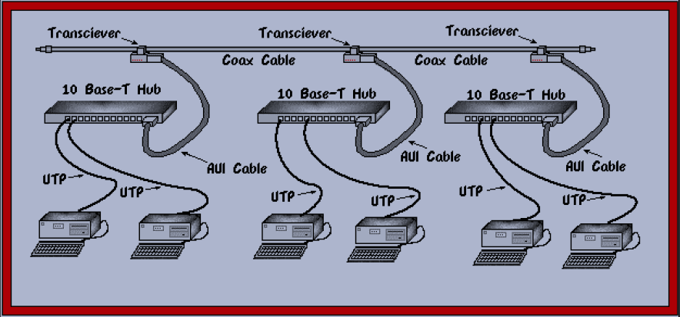
Using Hubs to Enlarge a LAN

Slide 74
Ethernet Topologies
(a) Linear, (b) Spine
(c) Tree, (d) Segmented.

Slide 75
Manchester Encoding

Slide 76
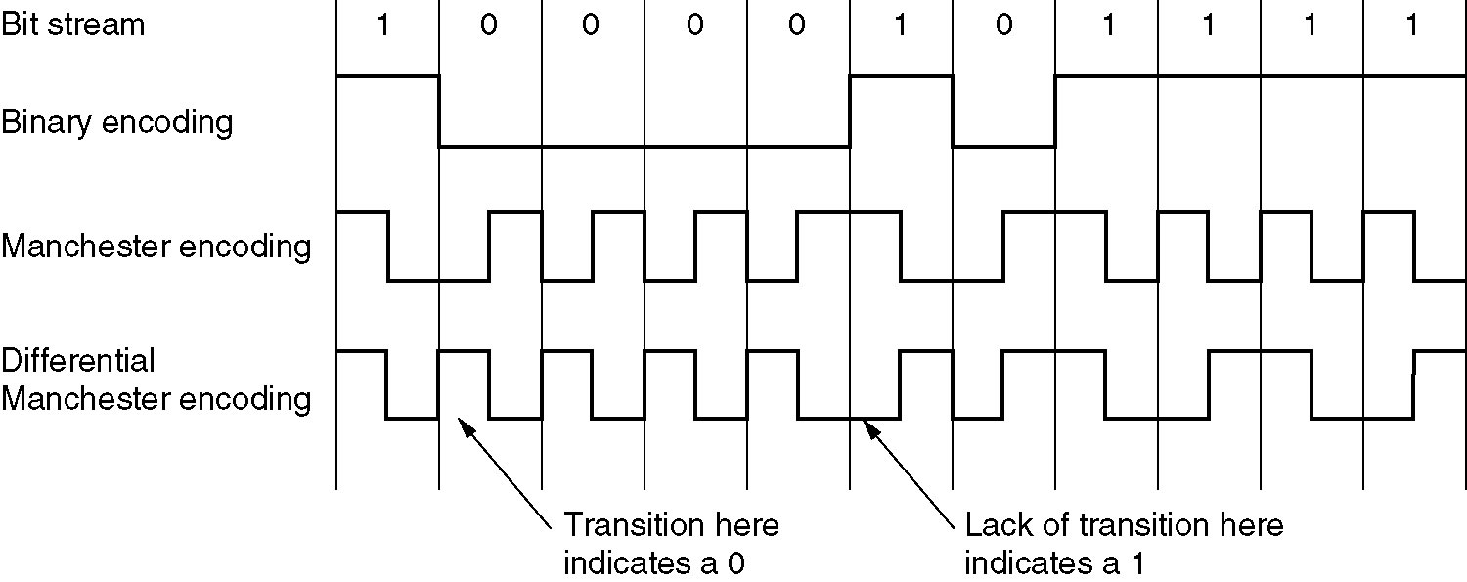
Manchester Encoding
(a) Binary encoding
(b) Manchester encoding
(c) Differential Manchester encoding

Slide 77
Ethernet MAC Sublayer Protocol

Slide 78
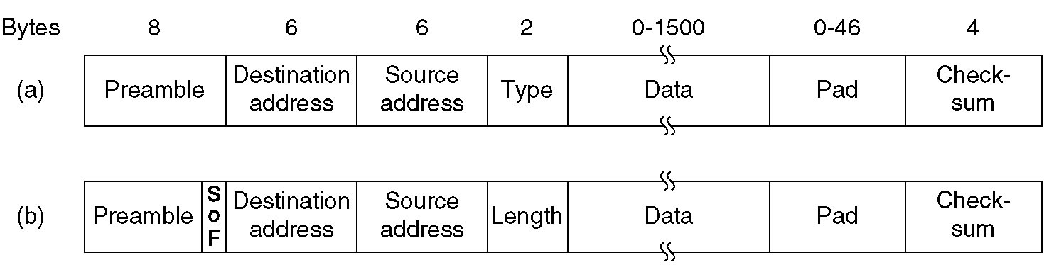
Ethernet MAC Sublayer Protocol
Type ( 0806:ARP, 0800:IP 8137:IPX)
Frame formats. (a) DIX Ethernet, (b) IEEE 802.3.

Slide 79
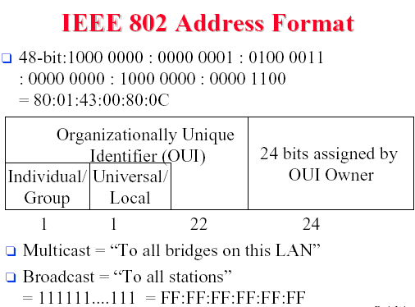
Ethernet address

Slide 80
Frame length
Maximum frame length
1514 byes (Data length 1500 bytes)
Based on the fact that a transceiver needs enough RAM to hold an entire frame and RAM was expensive in 1978
Minimum frame length
Valid frames must be at least 64 bytes long
If data portion is less than 46 bytes, Pad field is used to fill out the frame to the minimum size
Prevent a station from completing the transmission of a short frame before the first bit has even reached the far end of the cable, where it may collide with another frame
network speed
maximum cable length

Slide 81
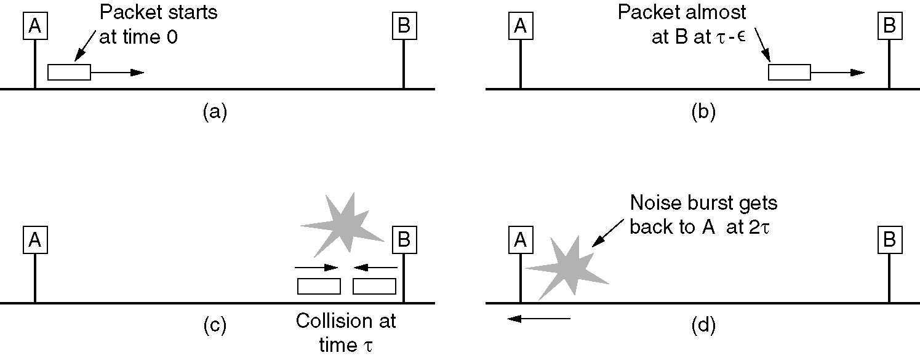
Minimum frame length

Slide 82
Binary Exponential Backoff Algorithm
time slots length: 512 bit times (51.2 µsec)
1st collision, random number 0~1
2nd collision, random number 0~3
….
9th collisoin, random number 0~511
10th collisoin, random number 0~1023
11th collisoin, random number 0~1023
…
16th collisoin, random number 0~1023
After 16 collisions, reports failure to computer
Further recovery is up to higher layers

Slide 83
IEEE 802.3 Performance
Frame length: F
Bandwith: B
Cable length: L
Speed of signal propagation: c
1
channel efficency =
1+2BLe/cF

Slide 84
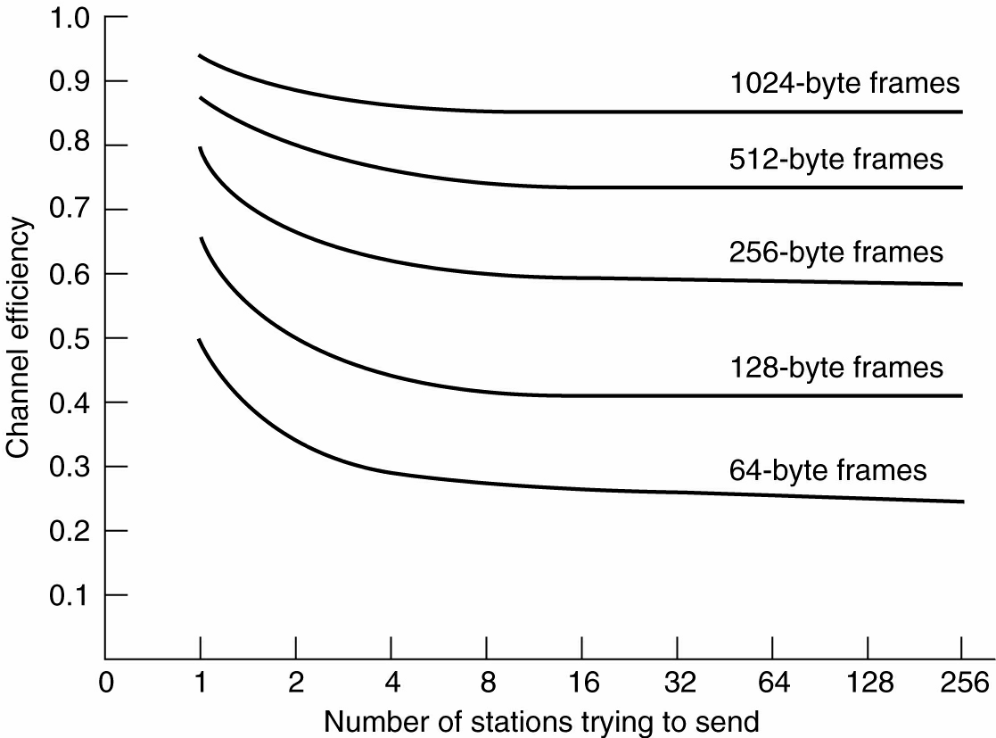
Ethernet Performance
Efficiency of Ethernet at 10 Mbps with 512-bit slot times

Slide 85
Switched Ethernet

Slide 86
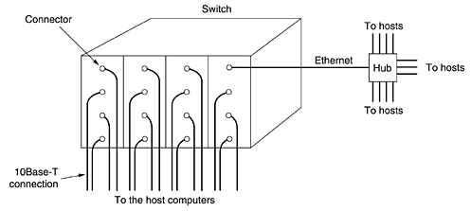
Switched Ethernet
High-speed backplane
Collision domain
With only one station per collision domain, collisions are impossible and performance is improved

Slide 87
Fast Ethernet

Slide 88
802.3u: A Soaped-up Ethernet
The need to be backward compatible with existing Ethernet LANs
The fear that a new protocol might have unforeseen problems
The desire to get the job done before the technology changed

Slide 89
Fast Ethernet
Keep all the old frame formats, interfaces, and procedural rules
Reduce the bit time from 100 ns to 10 ns
Reducing maximum cable length by a factor of 10
All fast Ethernet systems use hubs and switches; multidrop cables with vampire taps or BNC connectors are not permitted

Slide 90
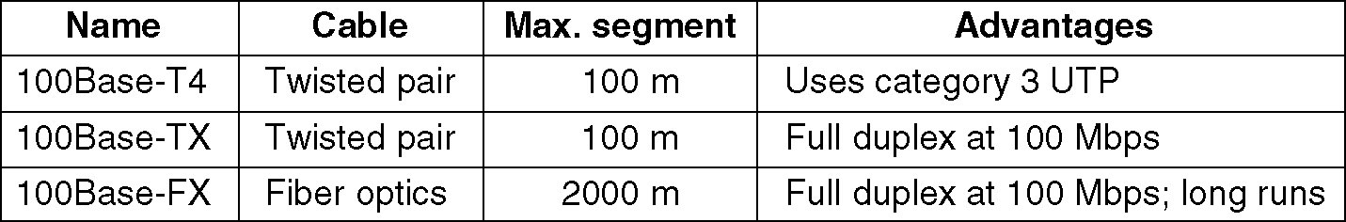
Fast Ethernet cabling

Slide 91
100Base-T4
Uses a signaling speed of 25 MHz
Requires 4 twisted pairs (category 3 UTP)
One is always to the hub
One is always from the hub
The other two are switchable to the current transmission direction
Coding
Manchester encoding is not used
Ternary signals are sent during a clock period
27 possible symbols, transmit 4 bits
At least 33.3-Mbps reverse channel(8B/6T)

Slide 92
100Base-TX
Uses a signaling speed of 125 MHz
Requires 2 twisted pairs (category 5 UTP)
One is to the hub
One is from the hub
(Full duplex)
Coding
4B/5B: 125 * 4/5 = 100Mbps

Slide 93
Interconnection Devices
Hub (Half-duplex communication)
Incoming lines are logically connected, forming a single collision domain
All the standard rules, including the binary exponential backoff algorithm, apply, so the system works just like old-fashioned Ethernet
Hubs are not permitted with 100Base-FX
Switch
Incoming frame is buffered and passed to the destination
100Base-FX cables are too long for collision algorithm, must be connected to switches

Slide 94
10-Mbps & 100-Mbps Autoconfiguration
802.3u provides a way for two stations to negotiate the speed (10 or 100 Mbps) and duplexity (half or full)
Most fast Ethernet products use this feature to autoconfigure themselves

Slide 95
Gigabit Ethernet

Slide 96
802.3z Goals
Make Ethernet go 10 times faster
Remain backward compatible with all existing Ethernet standards
Unacknowledged datagram service with both unicast and multicast
Use 48-bit addressing scheme already in use
Maintain the same frame format, including the minimum and maximum frame sizes

Slide 97
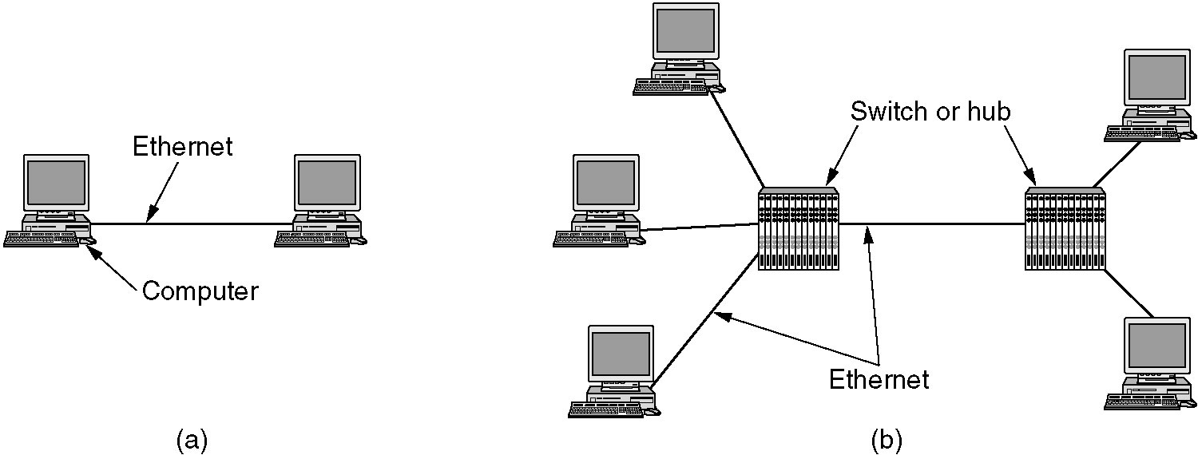
Gigabit Ethernet
A two-station Ethernet.
A multistation Ethernet.

Slide 98
Switch : Full-duplex Mode
Switch (Full-duplex Mode)
Since no contention is possible, the CSMA/CD protocol is not used
Maximum length of the cable is determined by signal strength issues
Switches are free to mix and match speeds. Autoconfiguration is supported

Slide 99
Hub: Half-duplex Mode
Simulating classic Ethernet
Electrically connects all the lines internally
Collisions are possible, so CSMA/CD protocol is required
Problem: A radius of 25 meters
Solutions
Carrier extension
Add padding after the normal frame to extend the frame to 512 bytes (Padding is added by the sending hardware and removed by the receiving hardware)
Frame bursting
Allows a sender to transmit a concatenated sequence of multiple frames in a single transmission
Remain the radius of the network to 200 meters

Slide 100
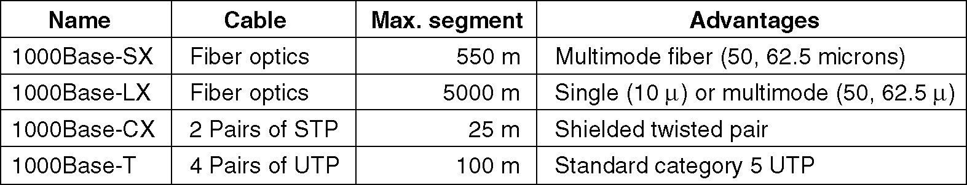
Gigabit Ethernet cabling

Slide 101
Flow Control
Problem: 1 Gbps is quite fast
If a receiver is busy with some other task for 1 ms, 1953 frames may have accumulated
When a computer is shipping data to a computer on a classic Ethernet, buffer overruns are very likely
Control frames
One end sending a special control frame to the other end telling it to pause for some period of time
Normal Ethernet frames containing a type of 0x8808
The first two bytes of the data field give the command; succeeding bytes provide the parameters.
Flow control
PAUSE frames are used, 512ns~33.6ms

Slide 102
Reasons for Longevity of Ethernet
Reliable
10base2:BNC
10BaseT
Cheap
Thin Ethernet and twisted pair wiring is relatively inexpensive
Interface cards are also low cost
Easy to maintain
No software to install
No configuration tables to manage
Adding new hosts is as simple as just plugging them in

Slide 103
10 Gigabit Ethernet

Slide 104
Where to be needed
Inside data centers
Exchanges to connect high-end routers, switches, and servers
In long-distance, high bandwidth trunks between offices
The long distance connections use optical fiber, while the short connections may use copper or fiber

Slide 105
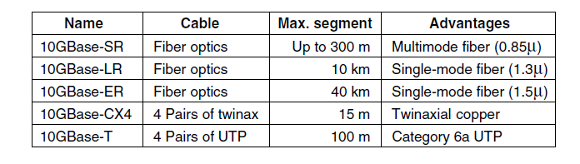
Kind of 10-gigabit Ethernet
Support only full-duplex operation
Interfaces autonegotiate
64B/66B code

Slide 106
4.4 Wireless LAN

Slide 107
802.11/WIFI

Slide 108
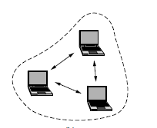
802.11 LAN architecture
wireless host communicates with base station
base station = access point (AP)
Basic Service Set (BSS)
wireless hosts
access point (AP): base station
ad hoc mode: hosts only
Internet
Switch or router
AP
BSS 1
AP
BSS 2

Slide 109
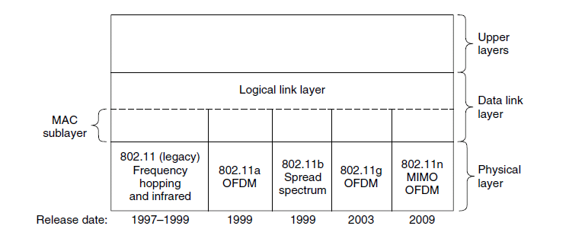
802.11 protocol stack

Slide 110
IEEE 802.11 Wireless LAN
802.11b
2.4-5 GHz unlicensed radio spectrum
up to 11 Mbps
direct sequence spread spectrum (DSSS) in physical layer
widely deployed, using base stations
802.11n
up to 600 Mbps
MIMO
802.11a
5-6 GHz range
up to 54 Mbps
OFDM
802.11g
2.4-5 GHz range
up to 54 Mbps
OFDM, like ADSL modem
All use CSMA/CA for multiple access
All have base-station and ad-hoc network versions

Slide 111
IEEE 802.11: multiple access
avoid collisions: nodes transmitting at same time
802.11: CSMA - sense before transmitting
don’t collide with ongoing transmission by other node
802.11: no collision detection!
difficult to receive (sense collisions) when transmitting due to weak received signals (fading)
can’t sense all collisions in any case: hidden terminal
goal: avoid collisions: CSMA/C(ollision)A(voidance)

Slide 112
CSMA/CA
802.11 MAC is different from that of Ethernet
Radios are always half duplex
Received signal is 10⁶ times weaker than the transmitted, collision detection mechanism does not work
Avoid collisions with a protocol called CSMA/CA
When a station has a frame to send:
Waits until the channel is idle by sensing and wait DIFS
Random backoff (0~15 time slots): counts down idle slots, pausing when frames are sent. Sends its frame when the counter reaches 0
If the frame gets through, destination sends a short ACK
Lack of an ACK is inferred to indicate a collision or other error, doubles the backoff period and tries again (as exponential backoff in Ethernet)
Notes:
StandardSIFS(μs)IEEE 802.11b 10 IEEE 802.11a 16 IEEE 802.11g 10
DIFS = SIFS + (2 * Slot time)
StandardSlot Time(µs)DIFS(µs)IEEE 802.11b 20 50 IEEE 802.11a 9 34 IEEE 802.11g 9 or 20 28 or 50 PIFS = SIFS + Slot time
StandardSlot time(µs)PIFS(µs)IEEE 802.11b2030IEEE 802.11a925IEEE 802.11g9 or 2019 or 30

Slide 113
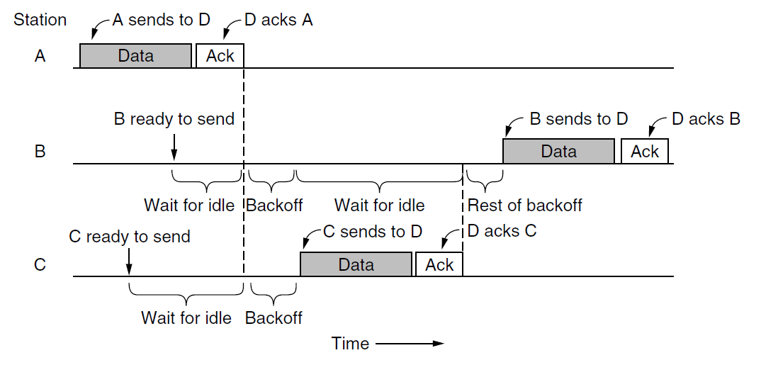
CSMA/CA

Slide 114
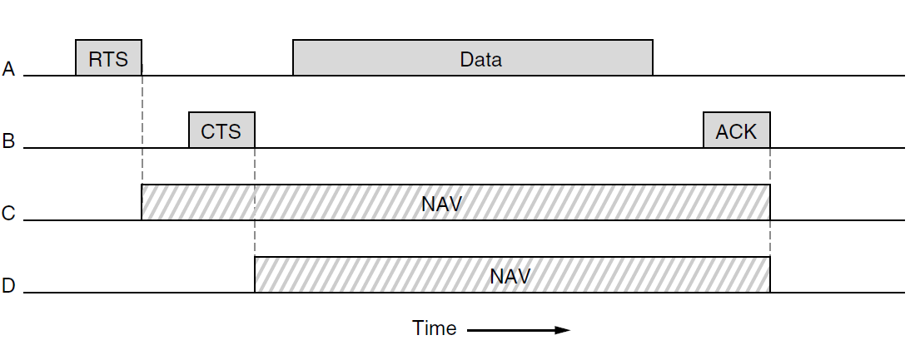
Channel Sensing
Physical sensing
Checks the medium to see if there is a valid signal
Virtual sensing
Each station keeps a logical record of when the channel is in use by tracking NAV (Network Allocation Vector)
Each frame carries a NAV
NAV of a data frame includes the time needed to send ACK
Optional RTS/CTS mechanism

Slide 115
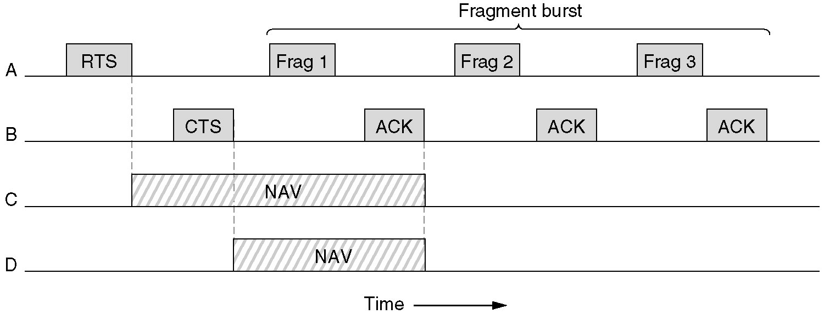
802.11 reliability
Lower the transmission rate
A fragment burst
.

Slide 116
802.11 Saving power
Beacon frames
Clients can enter power-save mode;
AP will buffer traffic;
the client sends a poll message to the AP
APSD (Automatic Power Save Delivery)
the AP buffers frames and sends them to a client just after the client sends frames to it

Slide 117
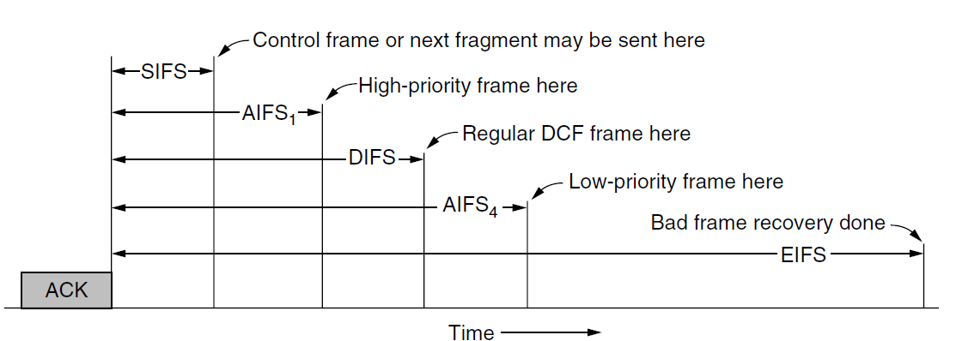
QOS:Interframe Spacing (IFS) in 802.11
DIFS (DCF) :Regular data frames
SIFS allow the parties in a single dialog
ACK frame
Other control frame sequences like RTS and CTS
A burst of fragments
AIFS1 (Arbitration InterFrame Space)
PCF, Voice or other high-priority traffic
AIFS4 used for background traffic

Slide 118
QOS:TXOP
Two stations: 6Mbps and 54M bps
They each get to send one frame, both get 5.4Mbps on average
Use TXOP
They get 3 Mbps and 27 Mbps, respectively

Slide 119
MAC Layer Frames
Data Frames
Control Frames
RTS,CTS,ACK
Management Frames
Beacon and Probe frames

Slide 120
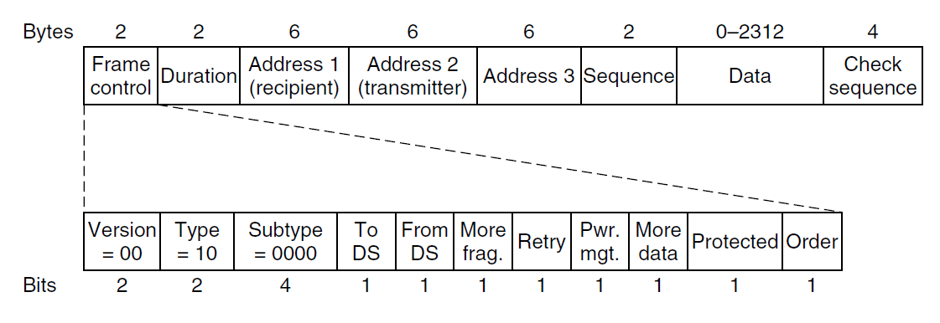
Format of the 802.11 Data Frame

Slide 121
802.11 frame: addressing
2
2
6
6
6
2
0 - 2312
4
frame
control
duration
address
1
address
2
address
3
seq
control
payload
CRC
Address 1: MAC address
of wireless host or AP
to receive this frame
Address 3: MAC address
of router interface to which AP is attached
Address 2: MAC address
of wireless host or AP
transmitting this frame

Slide 122
802.11 frame: addressing
Internet
H1
R1
router
AP
R1 MAC addr AP MAC addr
dest. address
source address
802.3 frame
AP MAC addr H1 MAC addr R1 MAC addr
address 1
address 2
address 3
802.11 frame

Slide 123
802.2: Logical Link Control

Slide 124
802.2: LLC
Run on top of 802.3 & other 802 protocols
Hides differences between the various kinds of 802 networks by providing a single format and interface to the network layer
LLC provides three service options
Unreliable datagram service
(best-efforts datagram service)
Acknowledged datagram service
(Error-controlled)
Reliable connection-oriented service
(Error-controlled & flow-controlled)

Slide 125
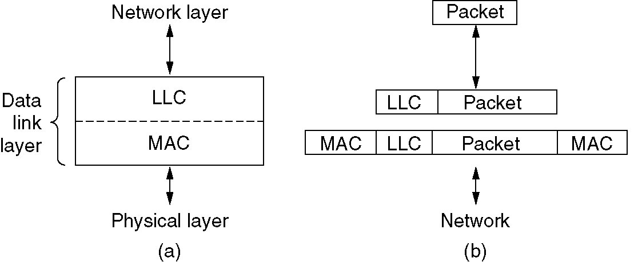
Position of LLC
(a) Position of LLC. (b) Protocol formats.

Slide 126
4.8 Data Link Layer Switching

Slide 127
Data Link Layer Switching
Bridges from 802.x to 802.y
Local Internetworking
Spanning Tree Bridges
Remote Bridges
Repeaters, Hubs, Bridges, Switches, Routers, Gateways
Virtual LANs

Slide 128
Local Internetworking

Slide 129
Data Link Layer Switching
The need for interaction
The organization may be geographically spread over several buildings
Split a single LAN into separate LANs to accommodate the load (multiple collision domains)
Physical distance(2500m)
Reliability
Security

Slide 130
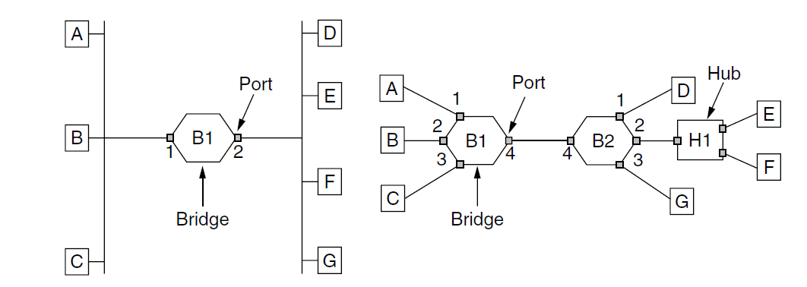
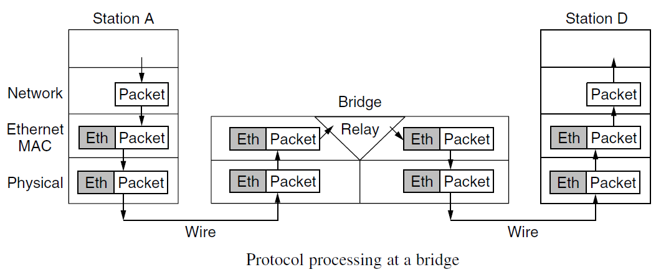
Bridge

Slide 131
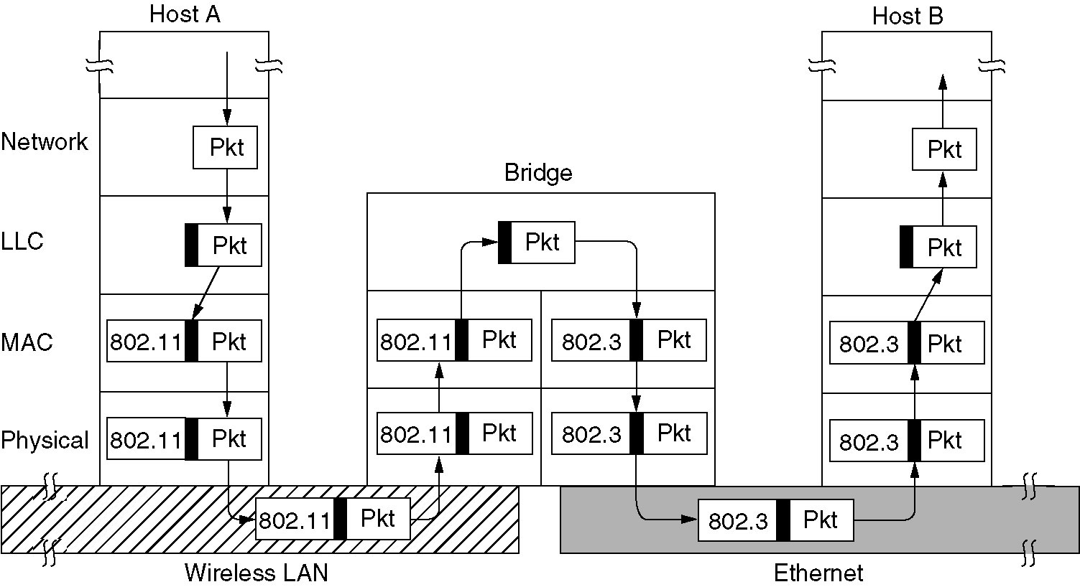
A LAN bridge from 802.11 to 802.3
Operation of a LAN bridge from 802.11 to 802.3.

Slide 132
Bridges from 802.x to 802.y
Problems
Each of the LANs uses a different frame format
LANs do not run at the same data rate
Different 802 LANs have different maximum frame lengths.
Security: Wireless networks support encryption in the data link layer, Ethernet does not
QoS (Quality of service：802.11、802.16)

Slide 133
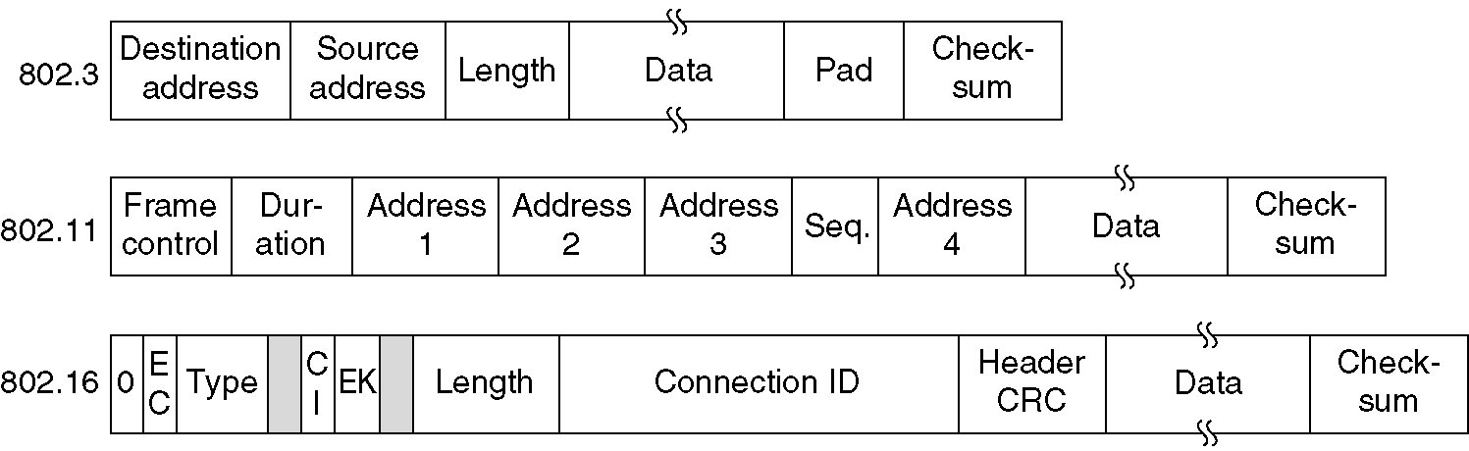
IEEE 802 frame formats

Slide 134
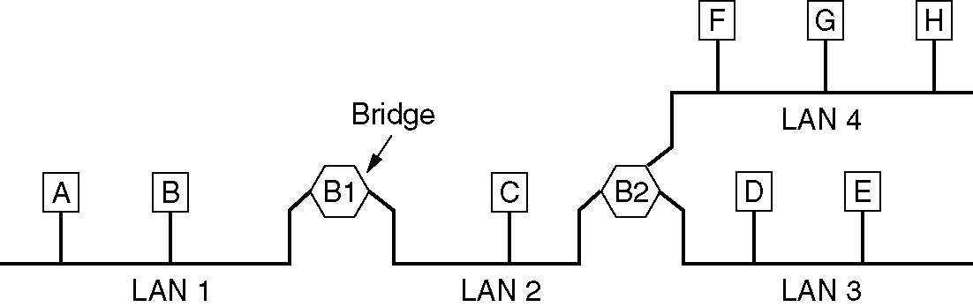
A configuration with 4 LANs & 2 bridges

Slide 135
Learning Bridge
（Transparent）

Slide 136
Learning Bridge
Operates in promiscuous mode
Accepting every frame transmitted on all the LANs to which it is attached
Station table
Lists each possible destination and tell which output line (LAN) it belongs on
Routing procedure for an incoming frame
If destination LAN and source LAN are the same, discard the frame
If destination LAN and source LAN are different, forward the frame
If destination LAN is unknown or multicast/broadcast address, use flooding algorithm
Flooding algorithm: output on all the LANs to which the bridge is connected except the one it arrived on

Slide 137
Station table: Backward Learning
Init
When the bridges are first plugged in, all the hash tables are empty
Add
Bridges operate in promiscuous mode, so they see every frame sent on any of their LANs
By looking at the source address, they can tell which machine is accessible on which LAN

Slide 138
Dynamic topologies
Problem
The topology can change as machines and bridges are powered up and down and moved around
Solution
Whenever a hash table entry is made, the arrival time of the frame is noted in the entry
Whenever a frame whose source is already in the table arrives, its entry is updated with the current time
Periodically scan the hash table and purges all entries more than a few minutes old
If a computer is unplugged from its LAN, moved around the building, and plugged in again somewhere else, within a few minutes it will be back in normal operation, without any manual intervention
This algorithm also means that if a machine is quiet for a few minutes, any traffic sent to it will have to be flooded until it next sends a frame itself

Slide 139
Example
B₁
B₂
1
2
1
2
A
B
C
D
E
F
MAC Intf
MAC Intf
A → B
A 1
A → B
A 1
F → C
F 2
F → C
F 2
…
…
B → A
B 1
…
…

Slide 140
Example2
B1 B2
1 A send frame to C A 1 A 2
2 E send frame to A E 2 E 3
3 D send frame to E D 3
4 E move to LAN2
5 E send frame to A E 2 E 2

Slide 141
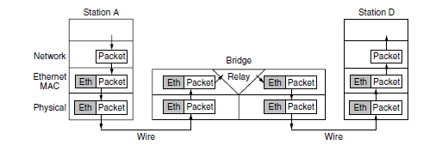
Protocol processing at a bridge

Slide 142
Spanning Tree Bridges

Slide 143
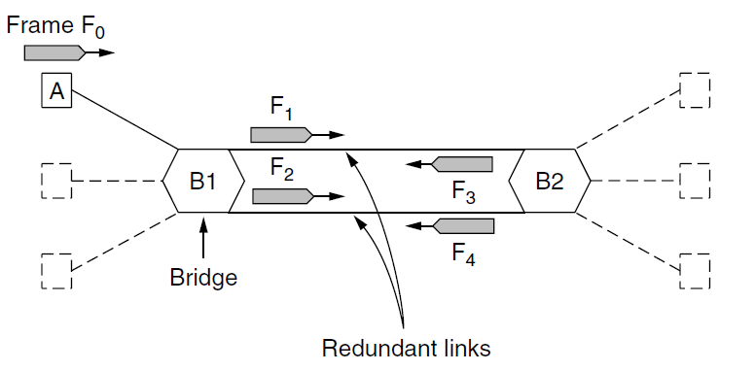
Loops in the Topology
Problem
To increase reliability, some sites use two or more bridges in parallel between pairs of LANs
This arrangement introduces problems because it creates loops in the topology

Slide 144

Spanning Tree Bridges
Solution (Radia Perlman, 1983)
Bridges communicate with each other and overlay the actual topology with a spanning tree that reaches every LAN
Using this spanning tree, there is exactly one path from every LAN to every other LAN, loops are impossible
Some potential connections between LANs are ignored in the interest of constructing a fictitious loop-free topology
Radia Perlman 2009
(born 1951)

Slide 145
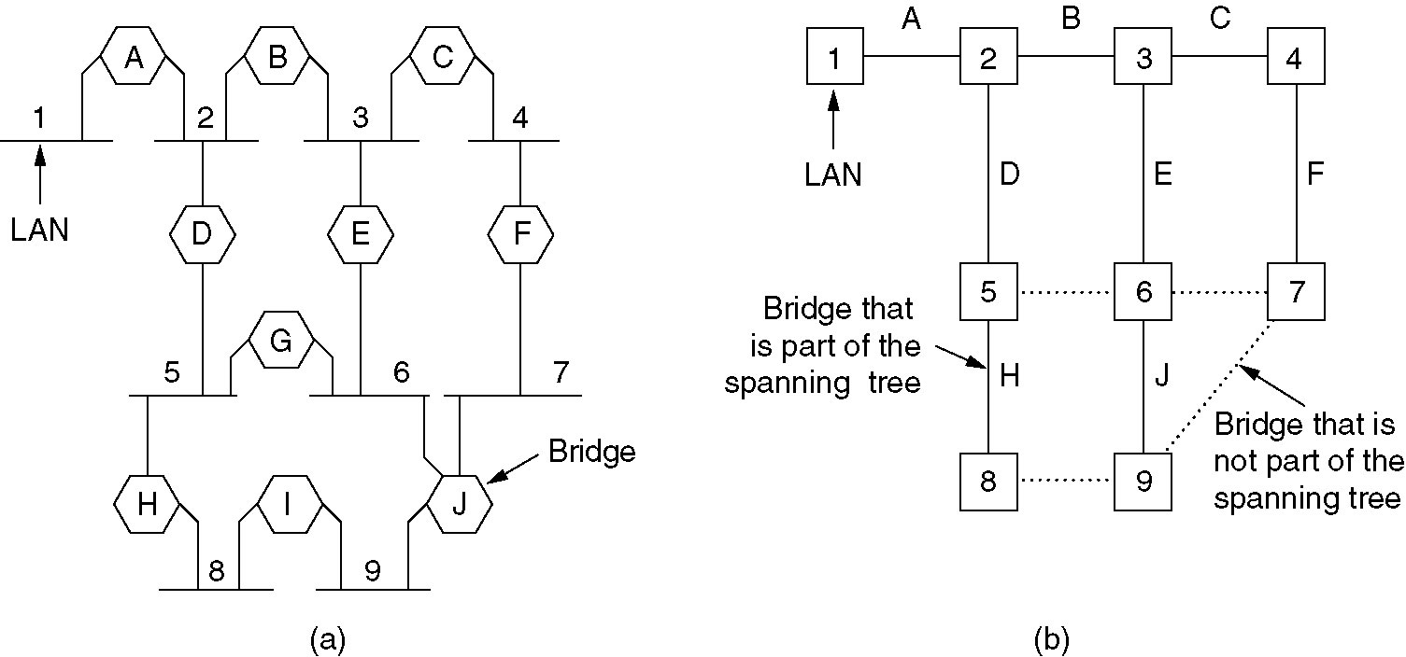
Spanning Tree Bridges
(a) Interconnected LANs. (b) A spanning tree covering the LANs. The dotted lines are not part of the spanning tree.

Slide 146
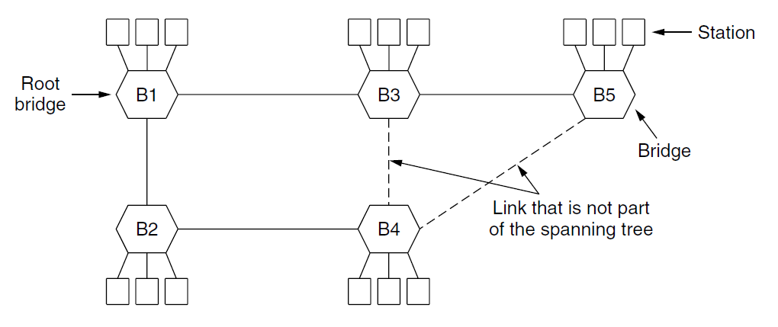
Spanning Tree Bridges

Slide 147
802.1d: Constructing the Spanning Tree
Bridge periodically multicast a message out all of its ports, this message is not forwarded, it includes:
an ID based on its MAC address
ID of the root it believe to be
the distance to root
Chose the bridge with the lowest ID to be the root, after enough messages exchanged, all bridges will agree on the root
Remembers the shortest path to root, if there are multiple equivalent paths, the path via bridge with lowest ID is chosen
Turn off ports that are not part of the shortest path
Algorithm continues to run during normal operation to automatically detect topology changes and update the tree

Slide 148
Dynamic Topologies
BPDU (Bridge Protocol Data Unit)
Bridge periodically multicast a message (MAC 01:80:c2:00:00:00) out all of its ports, this message is not forwarded, it includes:
an ID based on its MAC address
ID of the root it believe to be
the distance to root
Root Bridge of Whole Net
Chose the bridge with lowest ID to be the root, after enough messages exchanged, all bridges will agree on the root
Root Port of Every Bridge
Remembers the shortest path to root, if there are multiple equivalent paths, the path via bridge with lowest ID is chosen
Algorithm continues to run during normal operation to automatically detect topology changes and update the tree

Slide 149
Repeaters, Hubs, Bridges, Switches, Routers and Gateways

Slide 150
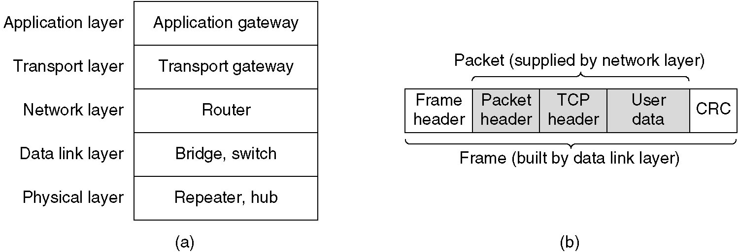
Repeaters, Hubs, Bridges, Switches, Routers and Gateways
(a) Which device is in which layer.
(b) Frames, packets, and headers.

Slide 151
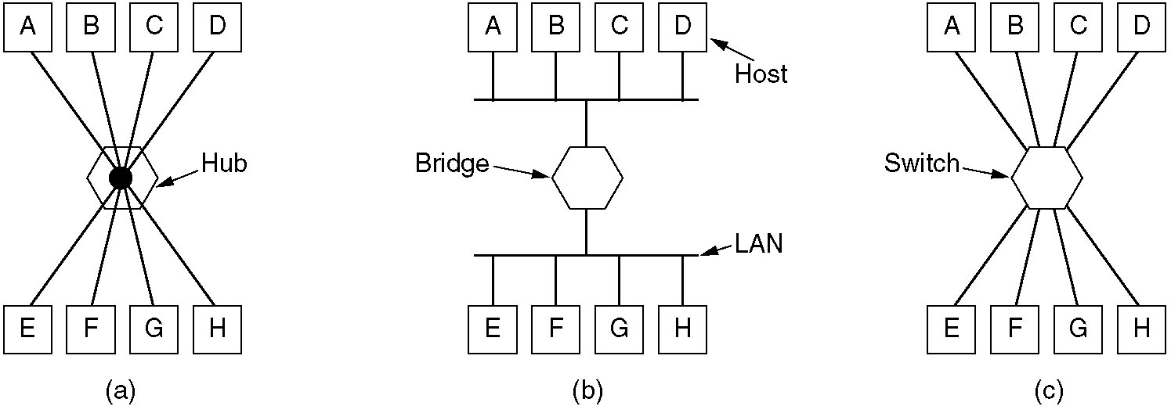
Hubs, Bridges, Switches
(a) A hub. (b) A bridge. (c) A switch.
Bridges & Switchs
Special-purpose VLSI chips lookup and update station table entry in a few microseconds
Buffer space: if frames come in faster than they can be retransmitted, the switch may run out of buffer space and start discarding frames
Cut-through switches

Slide 152
Virtual LANs

Slide 153
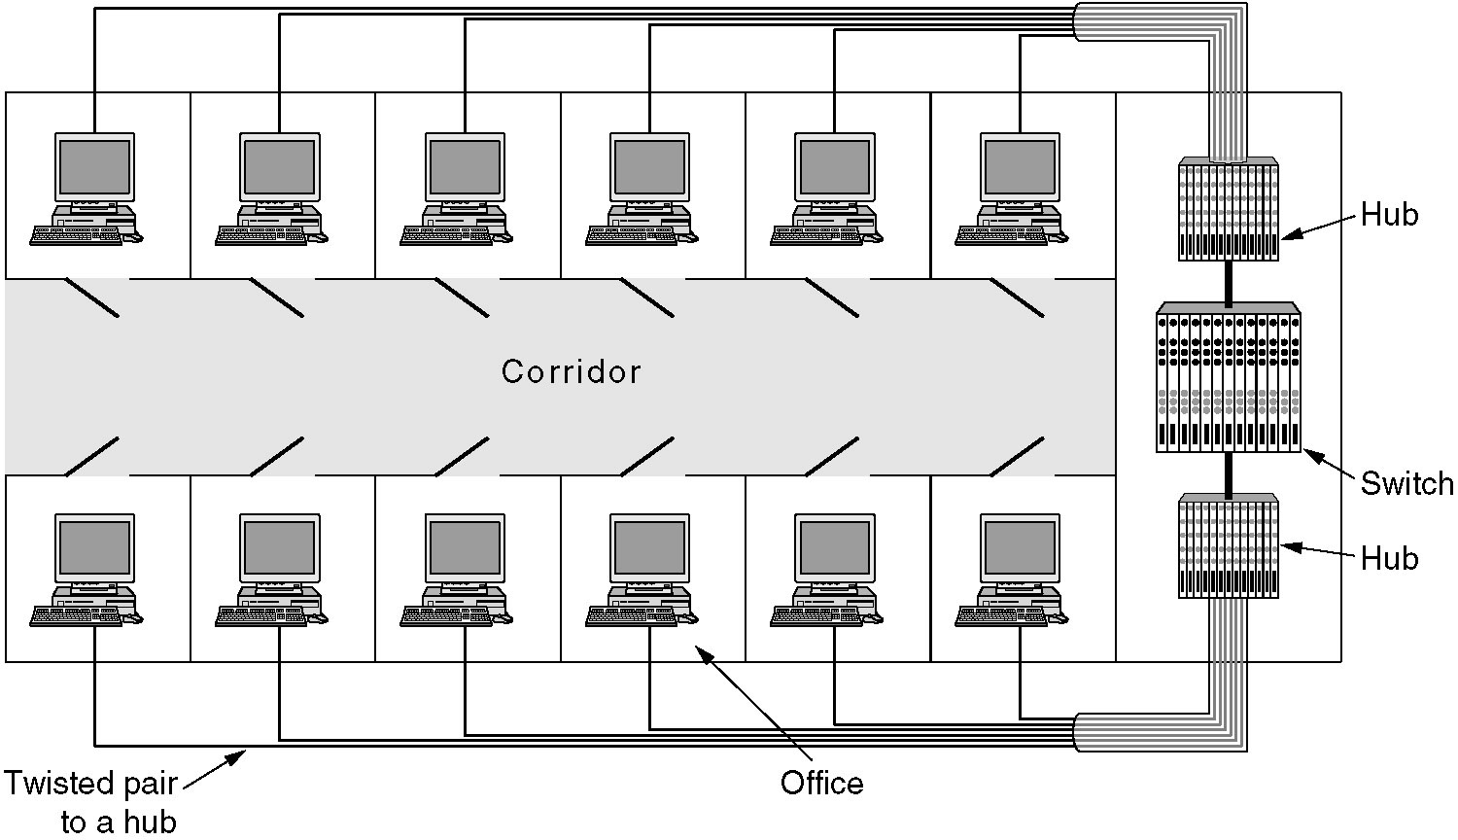
Virtual LANs
A building with centralized wiring using hubs and a switch.

Slide 154
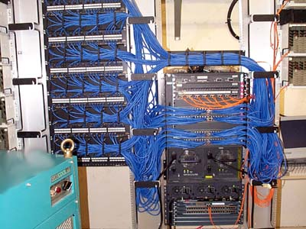
Virtual LANs
A building with centralized wiring using hubs and a switch.

Slide 155
Reason for Virtual LANs
Broadcast storm
LAN capacity is occupied by these frames
Machines are crippled just processing and discarding all the frames being broadcast
Security
Many departments have information that they do not want passed outside their department

Slide 156
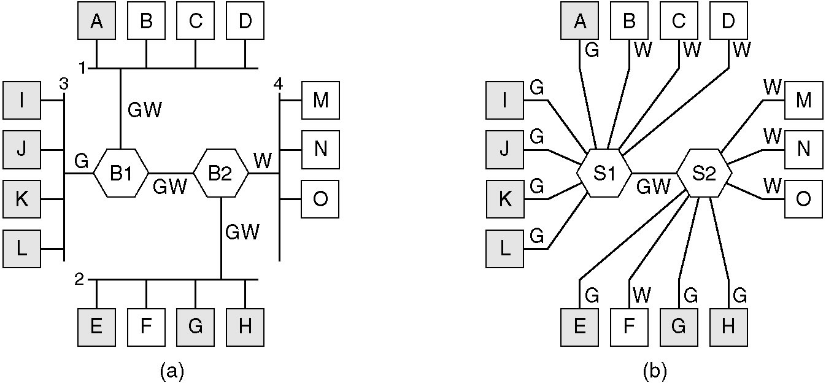
Virtual LANs
(a) Four physical LANs organized into two VLANs, gray and white, by two bridges.
(b) The same 15 machines organized into two VLANs by switches.

Slide 157
VLAN ID
In the switches, configuration tables tell which VLANs are accessible via which ports
Every port is assigned a VLAN ID
This method only works if all machines on a port belong to the same VLAN
Every MAC address is assigned a VLAN ID
When a frame arrives, the switch extracts the MAC address and look it up in a table to see which VLAN the frame came from
Every layer 3 protocol or IP address is assigned a VLAN ID

Slide 158

The IEEE 802.1Q Standard
Transition from legacy Ethernet to VLAN-aware Ethernet.
The shaded symbols are VLAN aware. The empty ones are not.

Slide 159

802.1Q: Frame formats
The 802.3 (legacy) and 802.1Q Ethernet frame formats.
VLAN protocol ID (16 bits): 0x8100
Pri (3 bits)
CFI (1 bit)
VLAN Identifier (12 Bits)
802.1Q Max frame length: 1522 bytes

Slide 160
Summary (1)
Static & Dynamic Channel Allocation
Multiple Access Protocols
ALOHA
Carrier Sense Multiple Access (CSMA/CD)
Collision-Free Protocols
Limited-Contention Protocols
Wireless LAN Protocols (CSMA/CA)
Ethernet
Ethernet Cabling
Manchester Encoding
Ethernet MAC Sublayer Protocol
Binary Exponential Backoff Algorithm
Fast Ethernet / Gigabit Ethernet /10 Gigabit Ethernet

Slide 161
Summary (2)
Data Link Layer Switching
Transparent Bridge
Spanning Tree Bridges
Remote Bridges
Repeaters, Hubs, Bridges, Switches, Routers, Gateways
Virtual LANs

Slide 162

About ALOHA
Norman Abramson先后毕业于
Harvard大学、UCLA（加州大学
Los Angeles分校）、Stanford
大学，分别获学士、硕士、博士学位，毕业后在Stanford大学电子工程系任教。1967开始任Hawaii大学信息与计算机科学系教授，并从事通信理论研究，领导ALOHA系统研究项目，提出了著名的ALOHA多址通信协议和CRC（循环冗余校验）专利技术，并成功建立了世界上第一个数据通信网络ALOHANET，开创了计算机局域网和现代数据通信网，同时也首先实现了无线分组数据接入方法。

Slide 163

About ETHERNET
1973年，为了实现几台电脑之
间的简单联接和信息交互，施乐
公司Palo Alto研究中心(PARC)
的研究员Bob Metcalfe描绘出了
大致的网络构想，并将这项技术
命名为“Ethernet”。当时的数据传输速率为
2.94Mbps，以太网就此诞生。

